Slide 1
No More Heroes: Why Team Composition is a BIG Deal
SREDay London Q1 2025
Pedro Ivo Raimundo – Cloud Engineering Manager

Slide 2
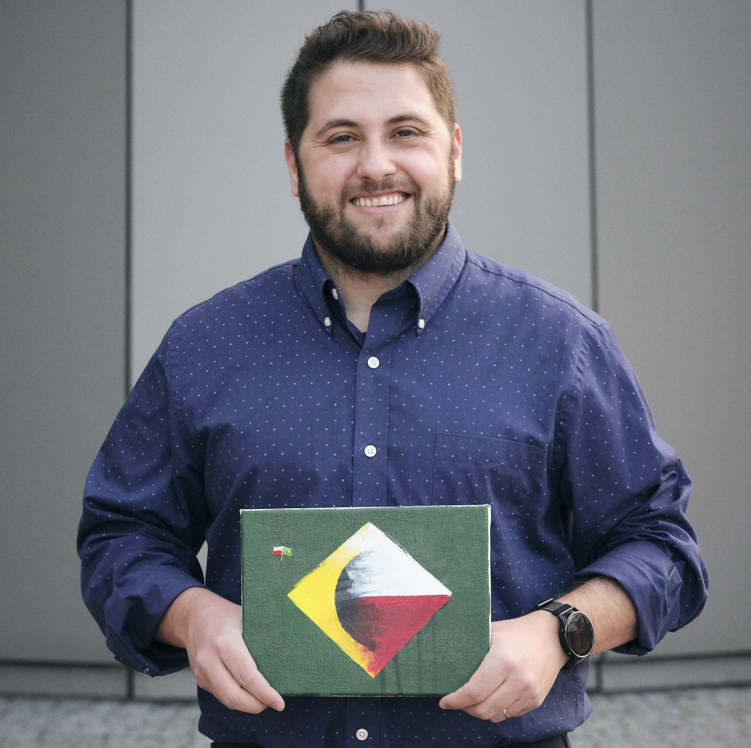

$ whoami
Pedro Ivo Raimundo
Fun facts that absolutely nobody asked for:
Cloud Engineering Manager @
Support/Ops > DevOps > Leadership
Currently based in Krakow/Poland 🇵🇱❤️
Spent more on unplayed Steam games than he likes to admit
Intro

Slide 3
Why should you care about TEAM COMPOSITION?
…bingo edition!

Slide 4
Bingo
Waited hours or even days for a different team to unblock your work/deliverable in some way
+1
Problem

Slide 5
Bingo
Had to save the day by fixing something very urgently (possibly during a coffee-fuelled rage at crazy hours or doing significant overtime)
+1
Problem

Slide 6
Bingo
Got redirected to a different teams/people multiple times under the same e-mail thread/group chat
+1
Problem

Slide 7
Bingo
Gets multiple emails/alerts/msgs per day with no value, meaningful information or action required from you
+1
Problem

Slide 8
Bingo Results
Problem

Slide 9
Bingo Results
0: You don’t work with IT
¯\_(ツ)_/¯
Problem

Slide 10

Bingo Results
1-2:
Problem

Slide 11

Bingo Results
3-4:
Problem

Slide 12
Studies
Study on Open Source Projects (2006):
Summary: Research on open-source projects found that when the developers’ communication patterns matched the software architecture, the projects were more successful and had fewer bugs.^{[2]}
Harvard Business Review Article (2012):
Summary: The article discusses how software and organizational architectures align, using examples from various tech companies to show that mismatches can lead to inefficiencies and integration issues. ^{[1]}
Problem

Slide 13
Summarizing the Problem(s)
The lack of planning to compose teams may cause:
Dependency bottlenecks
Communication gaps
High Cognitive Load
Inconsistent Practices
Scope Creep
Skill Gaps
Technical Debt
Siloed Information
Lack of Autonomy
Misaligned Goals
And all of that causes
FRUSTRATION!
Problem

Slide 14
Summarizing the Problem(s)
So… what explains that?
Problem

Slide 15
Before we dive into this rabbit hole
Team Composition definition (for this presentation's sake):
Macro: Organizing teams within an organization
(team-team interaction)
Micro: Interaction of individuals inside a team (people interaction)
Problem

Slide 16

Starting with Mario Macro: Lette go!
Macro

Slide 17
Conway’s Law
Macro

Slide 18
Macro: Conway’s Law (definition)
“Any organization that designs a system will produce a design whose structure is a copy of the organization's communication structure.”^{[3]}
(Melvin Conway, 1967)
Macro

Slide 19
Macro: Conway’s Law (definition)
"If you have four groups working on a compiler, you'll get a 4-pass compiler.”^{[4]}
(Eric S. Raymond, 1996)
Macro

Slide 20
Macro: Conway’s Law (in action)
Goal: Prepare a Birthday Party
Setup:
Team 1: Cake
Team 2: Music
Team 3: Decoration
Challenge: Team members live far away from each other and have little time to prepare
Macro

Slide 21

Macro: Conway’s Law (in action)
Scenario 1: Chaos
Macro

Slide 22

Macro: Conway’s Law (in action)
Team 1: Goes to a local cake shop they know
They get a discount on a “jungle-themed” cake
The cake looks and tastes good
Good investment value (price/quality)!
Macro

Slide 23

Macro: Conway’s Law (in action)
Team 2: Prepares a playlist with country songs
Based on their research, 60% of attendees enjoy it.
Good user research!
Macro

Slide 24
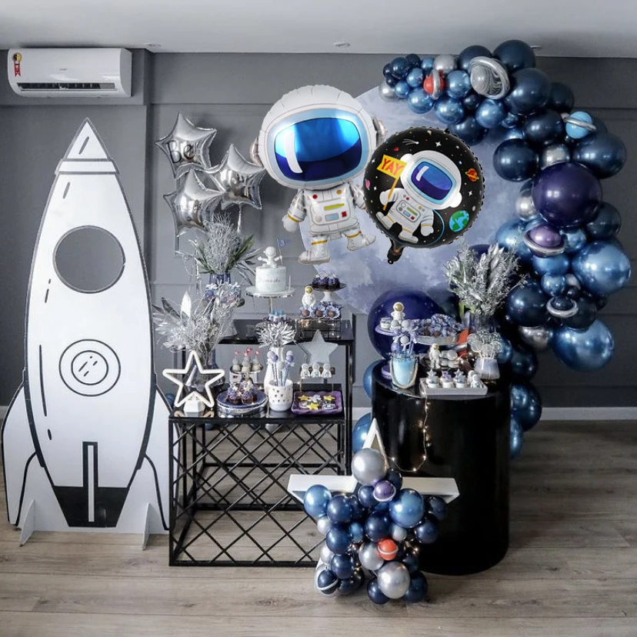
Macro: Conway’s Law (in action)
Team 3: Decorates the party with rockets and astronauts,
They found some decor remaining from last year still in good shape
Reutilization, cost/time saving!
Macro

Slide 25
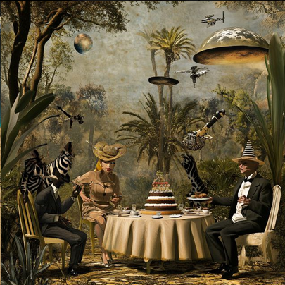
Macro: Conway’s Law (measuring results)
The party:
Macro

Slide 26
Macro: Conway’s Law (measuring results)
RCA for Scenario 1:
”Path of least resistance” org distribution:
Teams got selected without any prior strategy or planning
No correlation between team structure and desired architecture
Siloed information and decision making:
Teams took best decisions… for their own goals
Information was never exchanged
No common end goal was defined between all teams
Macro

Slide 27

Macro: Conway’s Law (in action)
Scenario 2: Fixing it
Macro

Slide 28
Macro: Conway’s Law (applying it)
To fix the “Tarzan meets Cowboy Bebop“ party, in next year, the team uses…
The Inverse-Conway-Maneuver (ICM)
Macro

Slide 29
Macro: Conway’s Law (applying it)
“The Inverse Conway Maneuver (ICM) is a strategy where an organization intentionally designs its team structure to achieve a desired system architecture”
in other words..
“Organizations should evolve their structure to achieve a desired architecture”^{[5]}
Macro

Slide 30
Macro: Conway’s Law (applying it)
So… what changed in the next year?
All Teams:
Agreed to a common party theme
Created new teams based on desired outcomes – not functions
Held short feedback touchpoints between the teams
New teams created:
Team 1: Cake and Decorations
Team 2: Music and Entertainment
Macro

Slide 31

Macro: Conway’s Law (applying it)
Team 1: Based on the data shared by the “Music and Entertainment” team research:
This time they buy a country-themed cake
They find a matching themed decor and strike a better deal
Macro

Slide 32
Macro: Conway’s Law (applying it)
Team 2: After review from the ”Cake and Decor”:
They remove songs from the playlist that were not appropriate for the children!
Then, they come up with an idea to add a “cowboys & bandits” activity for the kids
Macro

Slide 33
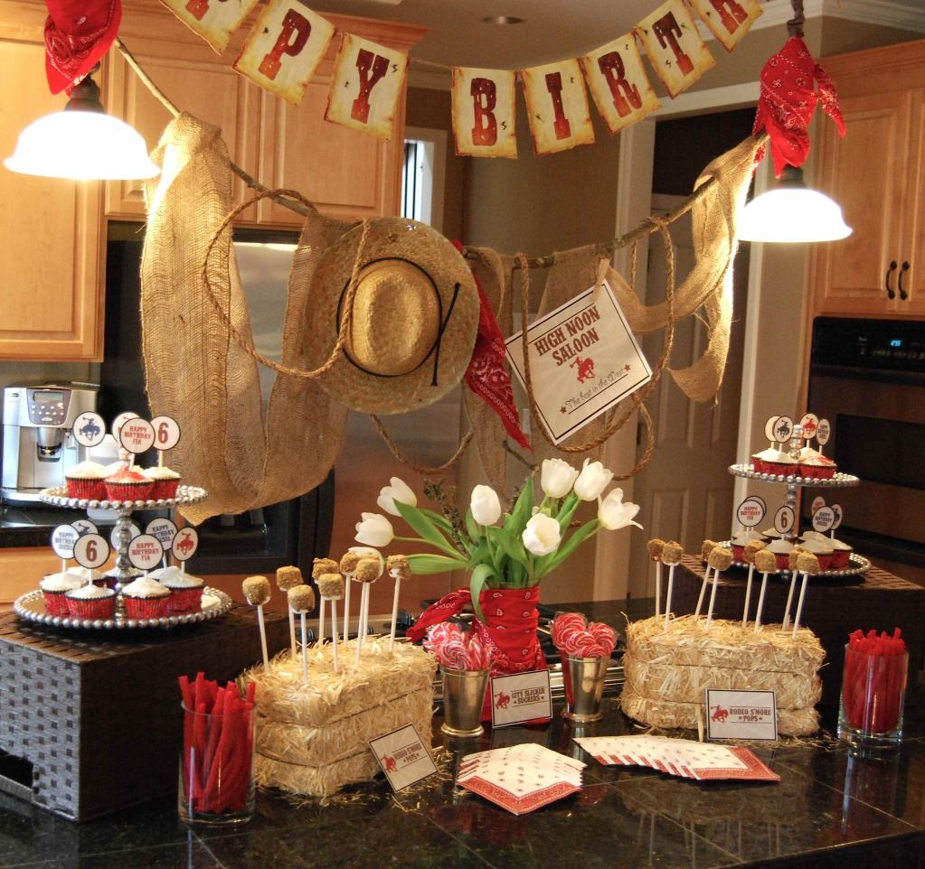
Macro: Conway’s Law (applying it)
Result:
Macro

Slide 34
Macro: Conway’s Law (takeaway)
“The first step in dealing with Conway's Law is know not to fight it.”^{[6]}
(Martin Fowler, 2022)
Macro

Slide 35
Macro: Breaking down team roles
So… how does that silly story translate to the real world?
Macro

Slide 36
Macro: Breaking down team roles
Typically, dev teams are separated by function:
Frontend, Backend, DB, QA, Ops, Support, etc…
Or sometimes by component/feature:
Search Engine, Authentication, Logging and Monitoring, etc…
Macro

Slide 37
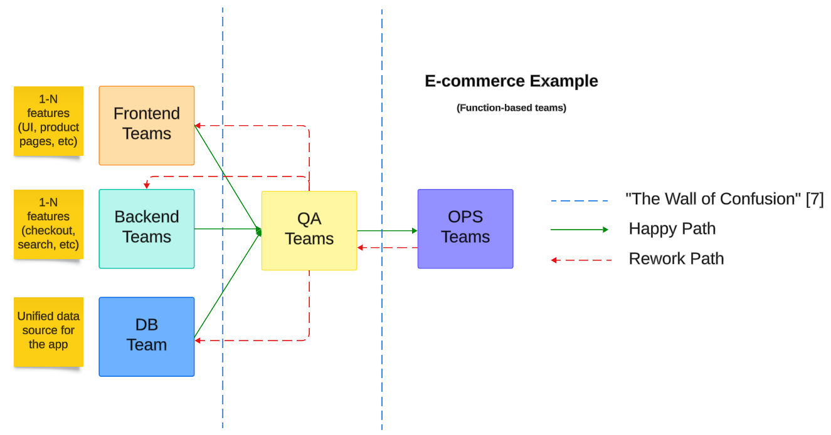
Macro: Breaking down team roles
Macro

Slide 38
Macro: Breaking down team roles
Why not separate teams by OUTCOME instead?
OUTCOME = End-to-end experience we desire to deliver
(Or in corpo-lingo: Result or impact that a team aims to achieve, which is aligned with business goals and customer needs)
Macro

Slide 39
Macro: Breaking down team roles
According to ”Team Topologies”^{[8]} there are four fundamental types of teams:
Stream-Aligned Teams
Enabling Teams
Complicated Subsystem Teams
Platform Teams (rings a bell, DevEx folks? ☺)
Macro

Slide 40
Macro: Stream-Aligned Teams
A stream-aligned team is assigned to a specific flow of work, fully responsible for delivering the desired outcome.
✅ End-to-end ownership (autonomy focused)
✅ Cross-functional (including roles such as devs, testers, POs, etc)
✅ Focused on outcomes (that can delivered via a product, a ”journey”, etc…)
Macro

Slide 41
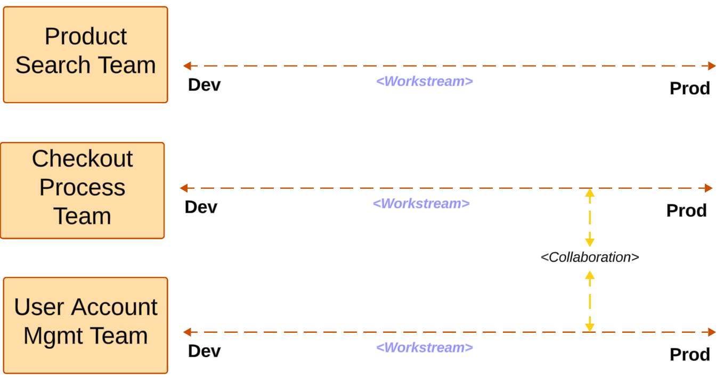
Macro: Stream-Aligned Teams
Macro

Slide 42
Macro: Enabling Teams
An enabling team assists teams by spreading knowledge, tools, and best practices.
Act as “internal consultants”, helping teams to adopt new technologies and methodologies.
✅ Serve to speed up enablement (specially stream-aligned teams)
✅ Help reduce cognitive load
✅ Dynamically assigned based on specific goals/challenges
Macro

Slide 43
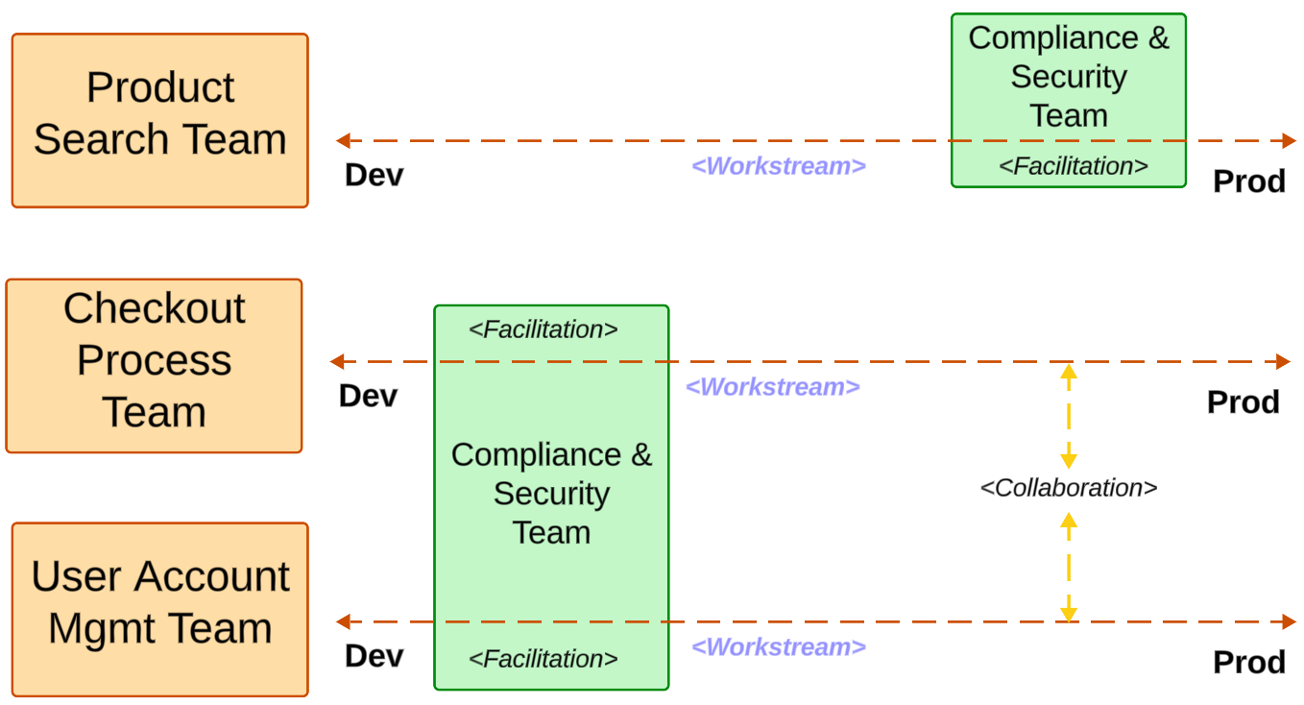
Macro: Enabling Teams
Macro

Slide 44
Macro: Complicated Subsytem Teams
A complicated subsystem team is responsible for a part of the system that requires specialized knowledge.
Examples: complex algorithms, highly technical components or specific domains.
✅ Formed by subject matter experts (SMEs)
✅ Focused on complex problem solving
✅ Help reduce cognitive load (teams can offload specialized work to CSTs)
Macro

Slide 45
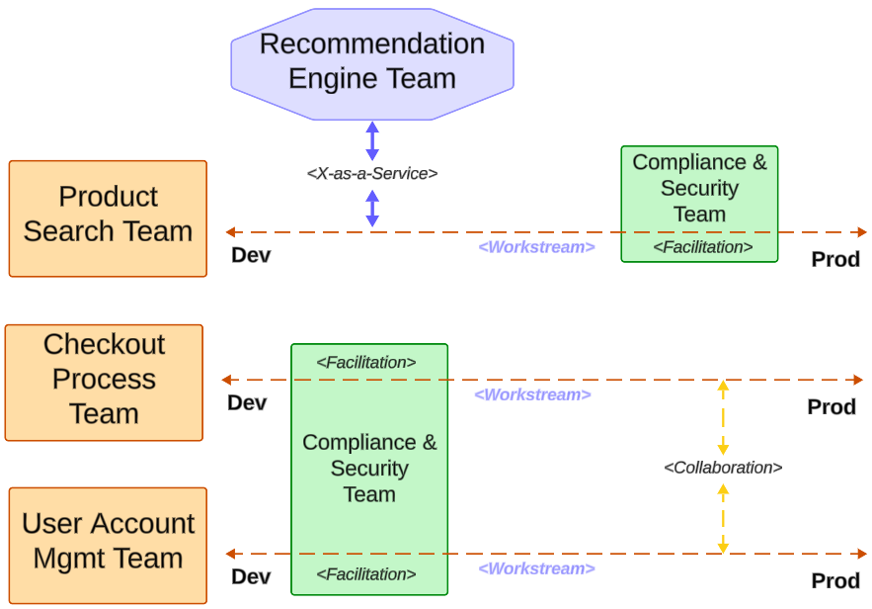
Macro: Complicated Subsytem Teams
Macro

Slide 46
Macro: Platform Teams
A platform team provides internal services and platforms to accelerate delivery by Stream-Aligned Teams.
The focus is creating reusable infrastructure, reducing cognitive load on other teams.
✅ Automation and reusability focused
✅ Delivering an amazing DevEx is their outcome
✅ Help reduce cognitive load (teams use platform team’s solutions to accelerate)
Macro

Slide 47
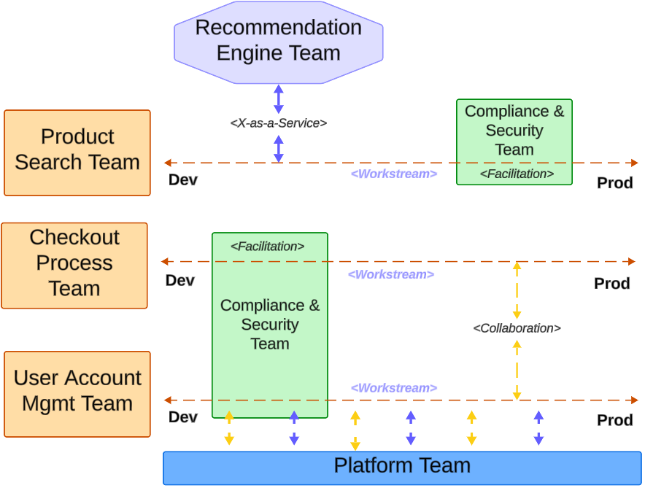
Macro: Platform Teams

Slide 48
Macro: Team Interaction Modes
Let’s once more refer to ”Team Topologies”^{[8]} about types of existing team interaction modes:
Collaboration
Facilitation
X-as-a-service
Macro

Slide 49
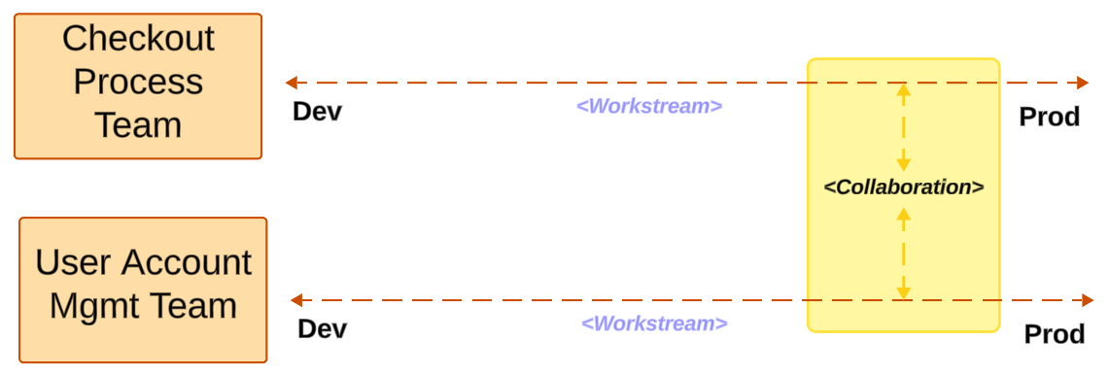
Macro: Team Interaction Modes: Collaboration
Macro

Slide 50
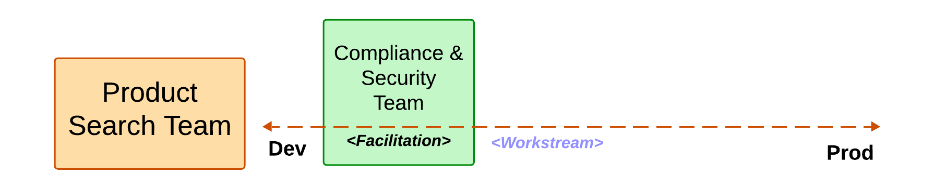
Macro: Team Interaction Modes: Facilitation
Macro

Slide 51
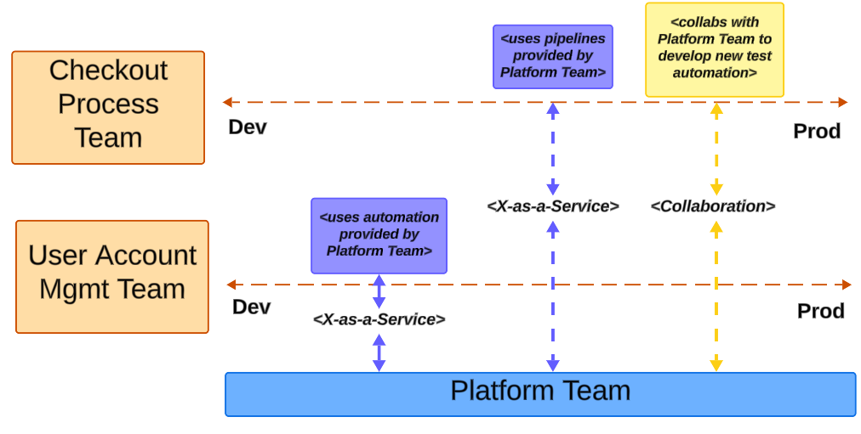
Macro: Team Interaction Modes: X-as-a-Service
Macro

Slide 52

Micro: How does all of that affect me?
To understand how that impacts you, it is time to get micro!
Micro

Slide 53
Micro: Cognitive Load
Cognitive Load refers to the total amount of mental effort being used in the working memory.
As a developer, cognitive load is your “CPU Brain capacity” to manage multiple activities at the same time
(coding, managing tools, requirements, and sometimes even talking to other people)
Micro

Slide 54
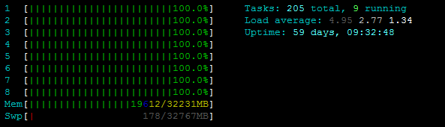
Micro: Cognitive Load
(Your brain after pushing that ‘small’ hotfix on prod, Friday 5pm)
Micro

Slide 55

Micro: Cognitive Load (The Hero Antipattern)
Micro

Slide 56

Micro: The Hero Antipattern
Let’s define HERO for this context
Sometimes, being a hero is a good thing:
Micro

Slide 57
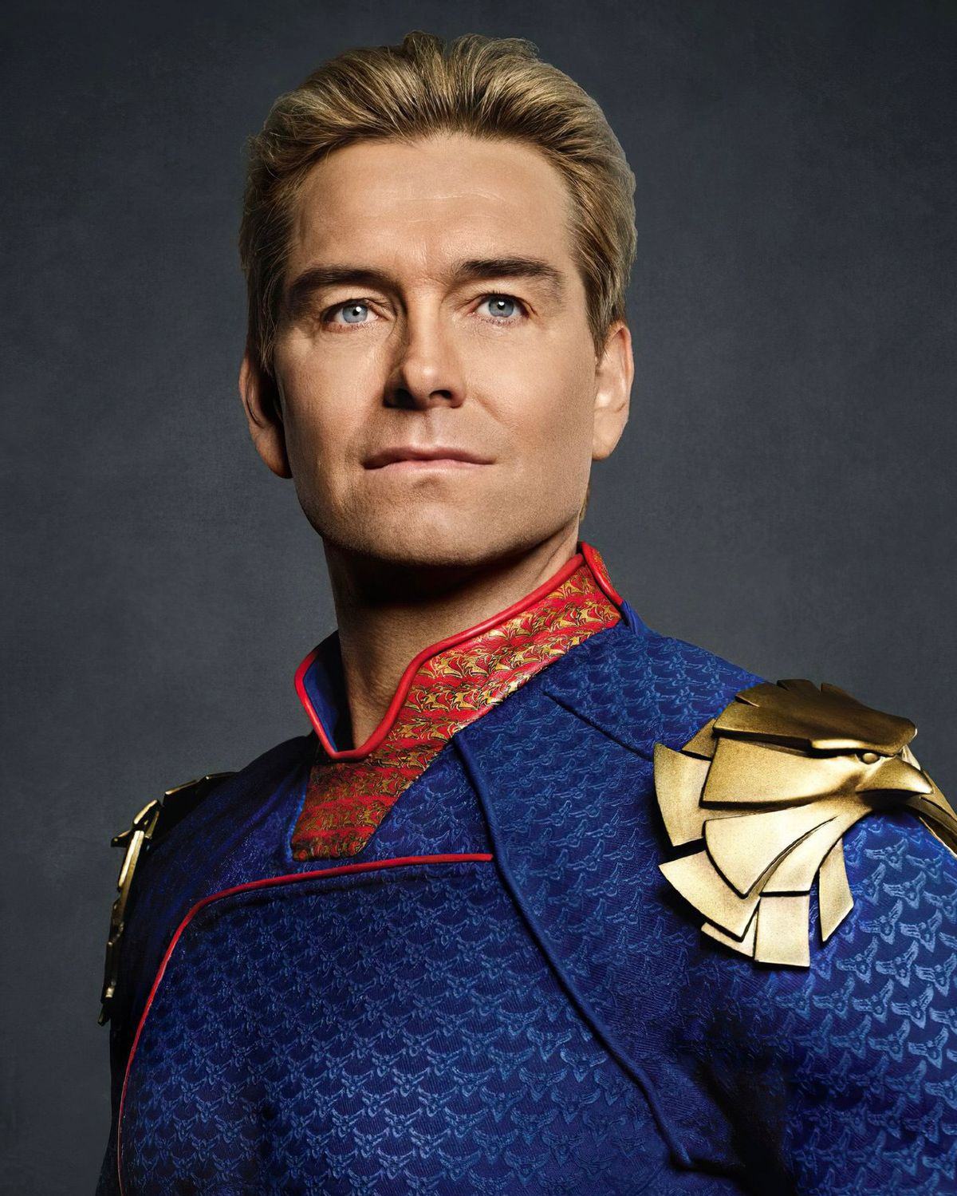
Micro: The Hero Antipattern
Let’s define HERO for this context
And sometimes…
not ☺
Micro

Slide 58
Micro: The Hero Antipattern
When it comes to the anti-pattern, a Hero:
Most of the time works under very high cognitive load
Has no time to do other things outside of urgent business needs
Likely to suffer from stress, burnout, and work longer hours
Usually can’t cooperate effectively (they are busy saving prod)
Due to their reputation, they will be requested often, perpetuating the cycle (imbalanced work distribution)
Tend to leave their current company in the long term (sometimes IT altogether)
Micro

Slide 59
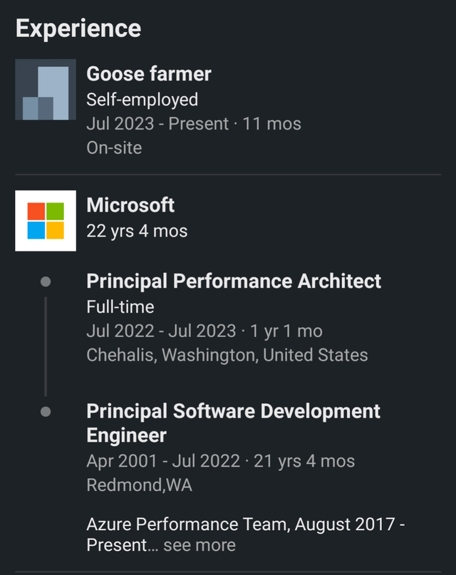
Micro: The Hero Antipattern
Micro

Slide 60
Micro: The Hero Antipattern
To avoid letting a hero live enough to become a goose farmer:
Well distributed and well scoped teams
Using the help of Platform and Complicated Subsystems teams
Ensuring teams have enough autonomy and ownership
Properly distributing work among team members (good team composition)
Not releasing on Friday ☺
Micro

Slide 61
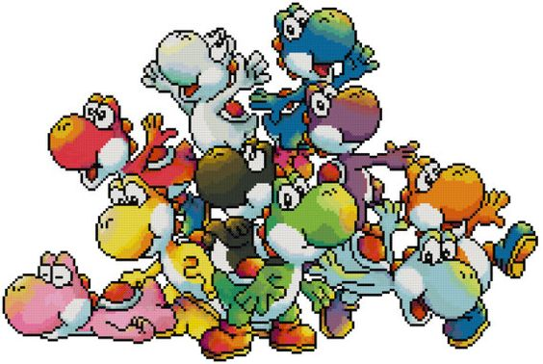
Micro: How do I apply all this findings?
Now let’s talk about how to apply those principles when building teams!
Micro

Slide 62

Micro: Concepts to Consider
Dumbar’s Number:
The theoretical cognitive limit of people a human can maintain a stable relationship with is around: ^{[9]} ~150 people
Two Pizzas Team:
A team should be small enough that it can be fed by with ^{[10]}
2x pizzas
(Jeff Bezos, circa 2000)
Micro

Slide 63
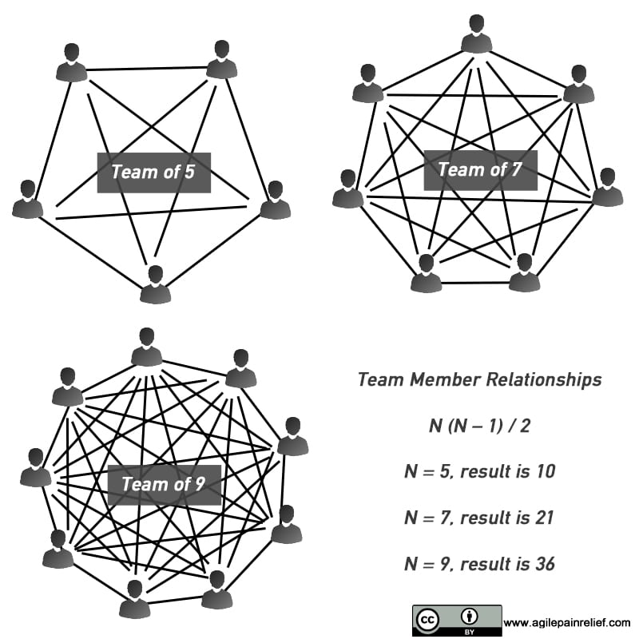
Micro: But why?
Well-sized teams have:
Better Cognitive Load Management ✅
More Efficient Communication ✅
Clear Team Boundaries ✅
Easier Cultural Cohesion ✅
And thus, the conclusion:
^{[11]}
Micro

Slide 64
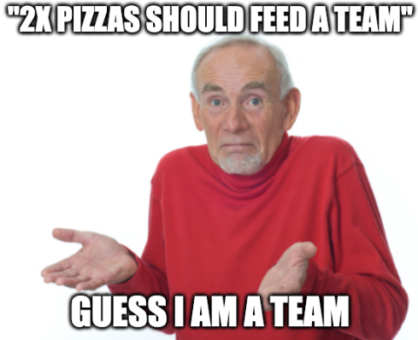
Micro

Slide 65
Actions:
What can I do about that (as a leader)?
Go deeper into Conway’s Law and its implications
Experiment with your team/org (micro AND macro)
Advocate to your leadership team about those concepts
Rethink how to plan for outcomes
Books, e-books, audiobooks! (recommendations in last slides)
Takeaways

Slide 66
Actions:
What can I do about that (as a dev)?
Inform, influence, speak up
As a senior, stretch your soft skills
Join the interview process for new joiners
Think about ownership as resolving problems, not simply creating features
Try temporary rotations, internal movements, new experiences
Takeaways

Slide 67
Last takeaways:
Team Composion is EXTREMELY context-specific (no silver-bullet)
Conway’s Law WORKS. Period.
Be intentional and thoughtful when introducing team changes
Consider how teams interact in your organization – DRAW IT!
Look for bottlenecks (“Any time spent on non-bottleneck activities is wasted time.”^{[12]})
Takeaways

Slide 68
Sources:
[1]: Baldwin, C. Y., & Clark, K. B. (2012). “The Architecture of Participation: Does Code Architecture Mitigate Free Riding in the Open Source Development Model?” Harvard Business Review.
[2]: Cataldo, M., Wagstrom, P., Herbsleb, J. D., & Carley, K. M. (2006). “Identification of coordination requirements: implications for the Design of collaboration and awareness tools”. CSCW '06.
[3]: Conway, Melvin E. (April 1968). "How do Committees Invent?". Datamation.
[4]: Raymond, Eric S. (October 1996). “The New Hacker's Dictionary (3rd ed.)”. Cambridge, Massachusetts: MIT Press. p. 124. ISBN 978-0-262-68092-9.
[5]: Forsgren, N. PhD, Humble, J., Kim, G., Bell, S., Whitley Bell, K. (2018). “Accelerate: The Science of Lean Software and DevOps: Building and Scaling High Performance Technology”, IT Revolution Press, 2018.
[6]: Fowler, M. (2022). “Conway's Law”. Thoughtworks. https://martinfowler.com
[7]: Shafer, A. (2009). “AgileRoots 2009 - Agile Infrastructure by: Andrew Shafer”. https://www.youtube.com/watch?v=Y_u84PNrX9g
[8]: Skelton, M., Pais, M. (2019). “Team Topologies: Organizing Business and Technology Teams for Fast Flow”. IT Revolution Press, 2019.
[9]: R.I.M. Dunbar (1992). “Neocortex size as a constraint on group size in primates”, Journal of Human Evolution, ISSN 0047-2484.
[10]: Bezos, J. (Circa 2000). Mentioned in “Powering Innovation and Speed with Amazon’s Two-Pizza Teams”. https://aws.amazon.com/executive-insights/content/amazon-two-pizza-team/
[11]: Levison, M. (2020). “What is the Recommended Scrum Team Size?” https://agilepainrelief.com/blog/scrum-team-size.html
[12]: Cox, J., Goldratt, E. (1986). “The Goal” Theory of Constraints. North River Press. ISBN 978-0-88427-178-9.
Wrap-up

Slide 69
My recommended books on the topic:
Team Topologies: Organizing Business and Technology Teams for Fast Flow – by Manuel Pais and Matthew Skelton (2019) (https://teamtopologies.com/)
Dynamic Reteaming: The Art & Wisdom of Changing Teams - by Heidi Helfand (2018) (https://www.heidihelfand.com/dynamic-reteaming-book/)
EMPOWERED: Ordinary People, Extraordinary Products – by Marty Cagan and Chris Jones (2020) (https://www.svpg.com/books/)
The Five Dysfunctions of a Team: A Leadership Fable – by Patrick Lencioni (2002) (https://www.tablegroup.com/pat/#books)
Wrap-up

Slide 70


Thank you, dziękuję, grazie, gracias obrigado! ☺
Git repo with slides
Wrap-up

